Slide 1
Domain Driven Design
Maciej Zelwak
Notes:
DDD is not a technology or methodology. DDD provides a structure of practices and terminology for making design deisions that focus and accelerate software projects complicated domains.

Slide 2
Agenda
1. Structuring domain logic
3. DDD main principles
- Layers
- Services
- Entities and Value Objects
- Aggregates
- Bounded Context
- Q Language
- Repositories
4. DDD Life cycle
5. Unit testing and refactoring

Slide 3
Why bother with models?
The critical complexity of most software projects is in understanding the business domain itself.
Notes:
Basically, models are one of our ways dealying with complexity. It’s one of our fundamental ways dealying with complexity. And the premise of DDD is that the critical complexity that you have to deal with is in the domain itself. Maybe you will have to deal with very complex business with a lot of business rules. Maybe you are dealying with some technical software that has to handle some complex computations, but the assumption is that where the critical complexity is. There may be technical impediments to be overcome that isn’t primary problem. This is how major of current applications works.
You can come with many examples of applications where it is not true. And that is good, because it shows that those applications are not good for DDD and are not good for modeling.

Slide 4
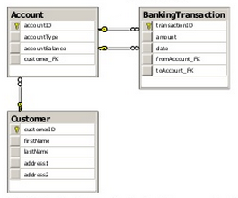
Structuring domain logic
Procedural database–driven design example
Web Tier
ASPX Controller
Business Tier
MoneyTransferService
TransferMoney(int from, int to, int amount)
Data Tier
Account
AccountID
AccountType
Balance
BankingTransaction
Customer
TransactionID
Amount
Date
CustomerID
FirstName
Address1
Address2
Maps
one – to – one
Notes:
Advantages:
It is easy to add new functionalities by implementing a new transaction script
Risks and disadvantages of this patterns:
Entities could be split into several entity-releated tables in the database due to normalization requirements
Posible redundancy in code
Does not scale well to complex business domain (problems with maintability)
---------------------------------
We usually don’t work on green field projects. Where you just come in and it is new system and you are going to design something that is great, because all brand new. When we work with the projects, there is already a system. And what is like is on this example. This is a scetch. This is fairly typical style. I see this sort of thinks a lot. And a service oriented architecture.
Let’s see how to change it to take advantage of domain modeling to make it more useful. I can see a couple of flaws that I can see with this design. Here is something that we call side effect. Any time we invoke the service, which does something very complicated, complex procedure, there is a banch of data that is dumped to database. And that is how you know that service is happened. This kind of side effected design is a problem. Is difficult to test, maintain beyond the certein level of complexity. This is the old principle of design to avoid such side effects.
And now, what is even more important. How much of this we can cover with existing domain model. If we gonna talk about this about this system with the user or a business person, a domian expert. What that conversation would be like? And recently I was in London where I had a lot of meetings. On one of them we were discusing new system. Trades got documentation before the meeting with functionalities and system architecture showing some services and database. During the conversation developer got his five minutes to elaborate a little new system. He mentioned that traders are using excels to collect some prices. The prices are evaluated prior to sending to another system. So far so good and then he has started talking about services and automated operations that will be done behind. The database where each operation of the service will be stored. In this point we have finished the metting without making any decision, traders didn’t respond to that monolog. This was really not desirable, but the fact is that we are missing vital understanding of the domain which is missing from design. they don’t care what services we have in the system and they will never come to us with requirements describing database schema.
In DDD it is called anti-corruption layer. When talking with business we focus in first line on modeling and business rules and we use ubiqutous language. I will talk more about this in a while.

Slide 5
Structuring domain logic
Procedural
Domain driven design
1. Procedural (Transaction Script)
- database driven
- logic concentrated in a set of
application services
- entities encapsulate only data without
behaviour
2. Domain model-based (Domain Model)
- logic concentrated in a set of business objects
- entities corespond to real-world objects
- Data Mappers are used to keep data independet
between domain model and database
3. Table-based record set (Table Module)
Presentation
Presentation
Business Tier
Business Tier
Transaction script
Transaction script
Data Object
Data Object
Data
Data Access Tier
Data Access Tier
- behaviour
- state
Notes:
Three types of requirements:
Functional
Non-functional
Domain
Three patterns of organizing domain logic:
Table-based record set (Table Module)
Procedural (Transaction Script)
Domain model-based (Domain Model)
-----------------------------------------------------------------------------------------------
We can discuss three types of requirements that any application software has to fulfill:
Requirements originating from users, which determine system’s purpose and how the system is used. These requirements are usually captured by Use Cases.
Non-functional requirements that capture quality attributes of the system: reliability, performance, seurity and many others.
Domain requirements, which capture essential domain concepts, their relationships and important rules. Business rules for instance control the way a business operations.
During my presentations I will interchengeably use terms: business rules, domain logic or business logic.
Historically, there have been several approaches to organizing and implementing business logic in applications. We can identify three patterns of organizing domain logic in enterprise applications:
Table-based record set (Table Module)
Procedural (Transaction Script)
Domain model-based (Domain Model)
Table and procedural:
- Largely database-driven in a sense that the relational model determines the structuring of domain objects and their releationships.
All logic concentrated in a set of heavyweight application services operating on database table-like objects, instead of actual business entities where they naturally belong.
Each method in service handles a single request from the presentation layer.
Domain objects do not encapsulate any business logic. They are simple data containers with properties, which is in a fundamental conflict with OO paradigm of encapsulating both data and behaviour. It is called as anemic domain model.
Domain pattern:
stresses the importance of decompling the object model from the database model
encapsulating all domain logic in a set of interconnected business objects is a way to manage complexity inherent in most business. Essentially, the business logic is modeled as operations on classes and spread among a collection of domain objects
- intended to be purely conceptual: classes in this model correspond to real-world objects. To ensure that data can be transparently passed between the two potentially diverging models very often Data Mapper is used (ex. Nhibernate, Entity Framework).
Table Module:
- in many ways a middle ground between a transript and domain
- doesn’t support technics structuring the logic, such as inheritance
- the biggest advantage is how it fits into the rest of the architecture. Many GUI environments are built to work on the results of a SQL query. You can easily run a query, manipulate the results in the (125), and pass the manipulated data to the GUI for display. action Script (110) and a Domain odel (116). Organizing the domain logic around tables rather than straight procedures provides more structure and makes it easier to find and remove duplication. However, you can't use a number of the t strategies, and other OO patterns.

Slide 6
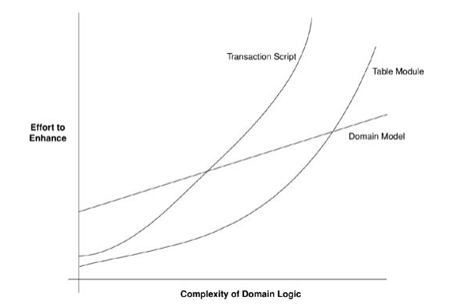
Structuring domain logic
Table vs Procedural vs Domain
When procedural style is better:
Very little domain logic
Mostly data entry and retrieval
Short deadlines
Prototypes
Low level of modeling skills
When domain model style is better:
Lots and lots of compliceted business logic
Long-lived project lifetime
Ambitious goals
High level of modeling skillks
Where is table module style?
Notes:
There are a number of benefits to having a domain model at the core of the application design:
- Firstly, because domain model is decoupled form the relational model, such design better reflects the reality of business.
- Stakeholders and developers are able to operate in terms of real business concepts. These concepts rarely change and are quite stable. Therefore it becomes possible to reuse the model in a new context (for example in new applications)
When procedural style seems to be better aproach:
Essentially, procedural style is better for simple, small applications and applications that don’t require high scalability and maintability
Can be better choice for applications storing and retrieving data (dropbox)
Domain driven desing applications usually require more coding in first feaze of development, therefore are not recommended for prototyping and projects with very short deadline
Finally, we need to have in the team at least one person with high level of modeling skills for domain modeling, otherwise you will have big mess.

Slide 7
What is domain?
Domain is sphere of knowledge or problem space, influence or activity.
Notes:
Domain means a lot of things to a lot of people.
Every software program relates to some activity or interest of its user. That subject area to which the user applies the program is the domain of the software. Some domains involve the physical world: The domain of an airline-booking program involves real people getting on real aircraft. Some domains are immaterial: The domain of an accounting program is money and finance. Software domains usually have little to do with computers, though there are exceptions: The domain of a source-code control system is software development itself. To create software that is valuably involved in users' activities, a development team must bring to bear a body of knowledge related to those activities. The breadth of knowledge required can be daunting. The volume and complexity of information can be overwhelming.
Models are tools for grappling with this overload. A model is a selectively simplified and consciously structured form of knowledge. An appropriate model makes sense of information and focuses it on a problem.
A domain model is not a particular diagram; it is the idea that the diagram is intended to convey. It is not just the knowledge in a domain expert's head; it is a rigorously organized and selective abstraction of that knowledge. A diagram can represent and communicate a model, as can carefully written code, as can an English sentence.
Domain modeling is not a matter of making as "realistic" a model as possible. Even in a domain of tangible real-world things, our model is an artificial creation. Nor is it just the construction of a software mechanism that gives the necessary results. It is more like moviemaking, loosely representing reality to a particular purpose. Even a documentary film does not show unedited real life. Just as a moviemaker selects aspects of experience and presents them in an idiosyncratic way to tell a story or make a point, a domain modeler chooses a particular model for its utility.
But what is a Domain? A Domain is a “sphere of knowledge”, for instance the business the company runs. A Domain is also called a “problem space”, so the problem for which we have to design a solution.

Slide 8
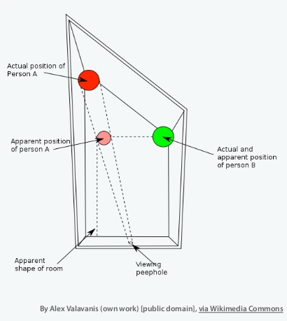
What is model?
Notes:
Ames Room
World Map
----------------------------------------------------
For some people model is synonim of UML diagram and for some people it is certain layer of application architecture. There is lot of definitions and DDD has it’s own.
Ames Room
Used in The Lord Of The Rings: The Fellowship of the Ring to make the hobbits apear the correct size in relation to Gandalf. We are always using mental models to understand the world around us – we do not perceive an object reality.
World Map
This eighteenth-century Chinese map represents the whole world. In the center and taking up most of the space is China, surrounded by perfunctory representations of other countries. This was a model of the world appropriate to that society, which had intentionally turned inward. The worldview that the map represents must not have been helpful in dealing with foreigners. Certainly it would not serve modern China at all. Maps are models, and every model represents some aspect of reality or an idea that is of interest. A model is a simplification. It is an interpretation of reality that abstracts the aspects relevant to solving the problem at hand and ignores extraneous detail.

Slide 9
What is model?
Model is a system of abstractions that describes selected aspects of a domain and can be used to solve problems related to that domain.
Not „as realistic as possible”
Allows software to enter the domain
There are always multiple models

Slide 10
Ubiquious language
Ubiquitous Language
- Domain concepts
- „Big picture” view of the system
- Subdomains
Solution space
- Technical aspects of design
- Technical terms
- Design patterns
Problem space
- Business terms developers don’t understand
- Familiar business terms not relevant to the syste, under design
Notes:
/ubiques/
In DDD we are in the situation that we have developed our model which is based on our iteractions with domain expert which is also going to be related to our implementation as we have created something with ubiquitous language. Where ubiquitous means everywhere. There is one language that we speak throught out our whole process and throught out artefacts. We have our language in the model and speaking to business users. We use this language when programing. When we achive that we can eliminate a lot of pitfalls. Such as the software doesn’t do what be user expceted to do. User see some nice word in menu, but two layers below it means completelty different thing.

Slide 11
Ubiquious language
Ubiquitous language is a language structured around the domain model and used by all team members to connect all the activities of the team with the software.
Notes:
Financial analysts crunch numbers. Effective domain modelers are knowledge crunchers. They take a torrent of information and try organizing one idea after another, searching for the simple view that makes sense of the mass.

Slide 12
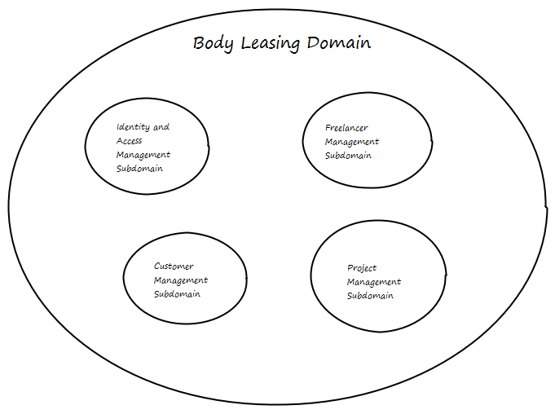
A Model expressed in software Bounded Context
Context is the setting in which a word or statement apears that determines its meaning.
Notes:
We said that we have one language in all those different processes like talking with domain experts or writing the code. Now I would like to modify it a little. We have one language in specific context. In fact in one system we have different subsystems doing something completely different. And each of this subsystems can have different languages.
It is very important to remember that the same word will have different meaning in different context and in specific scenario can have more or less sense.
Multiple models coexist on big projects, and this works fine in many cases. Different models apply
in different contexts. For example, you may have to integrate your new software with an external
system over which your team has no control. A situation like this is probably clear to everyone as
a distinct context where the model under development doesn't apply, but other situations can be
more vague and confusing.
Even a single team can end up with multiple models. Communication can lapse, leading to subtly
conflicting interpretations of the model. Older code often reflects an earlier conception of the
model that is subtly different from the current model.
Multiple models are in play on any large project. Yet when code based on distinct
models is combined, software becomes buggy, unreliable, and difficult to understand.
Communication among team members becomes confused. It is often unclear in what
context a model should not be applied.
Failure to keep things straight is ultimately revealed when the running code doesn't work right, but
the problem starts in the way teams are organized and the way people interact. Therefore, to
clarify the context of a model, we have to look at both the project and its end products (code,
database schemas, and so on).
A model applies in a context. The context may be a certain part of the code, or the work of a
particular team. For a model invented in a brainstorming session, the context could be limited to
that particular conversation.
Explicitly define the context within which a model applies. Explicitly set boundaries in
terms of team organization, usage within specific parts of the application, and physical
manifestations such as code bases and database schemas. Keep the model strictly
consistent within these bounds, but don't be distracted or confused by issues outside.

Slide 13

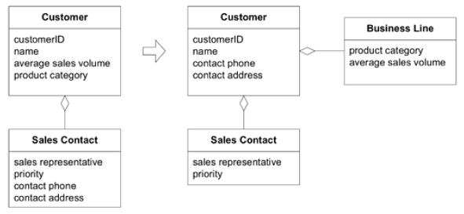
A Model expressed in software Entities
„An object primarily defined by its identity is called an Entity.”
Notes:
One of the most important fundamental concepts to understand is the definition of Entity in Domain -
Driven Design. According to Evans “ An object primarily defined by its identity is called an Entity. ”
Entities are very important in the domain model, and need to be designed carefully. Sometimes what
people think of as an entity in one system is not an entity in another system.
-----------------------------------------------
Example: an address
In some systems, an address may not have an identity at all; it may only represent attributes of a person or
company. In other systems, such as a cable television company or a utility company, the address could be
very important. In those systems, the address is important as an identity because the billing may be tied
directly to the address. In that case, the address would definitely be classified as an entity. In other
systems, such as an e - commerce web site, the address may only be used for determining where to send
an order, and the identity of the address may not really matter much, just the attributes of the address so
that the order can be fulfilled. In those types of cases, the address becomes what is called in Domain - Driven
Design a Value object.
Entity should have clearly defined state and behavior. At the same time, this behavior should not extend beyond the limits of the object's boundaries.

Slide 14
A Model expressed in software Value Objects
„These are the objects that describe things.”
Notes:
Unlike Entity objects, Value objects:
- haveno identity
- are very easy to create and discard
---------------------------------------------------------------
Most of the time, Value objects usually contain either just data or just behavior. The ones that contain only data are also known as Data Transfer Objects (DTOs).
A very common scenario is for an Entity to contain other Value objects. There are also times where Value objects can contain other Value objects, even other Entity objects. Most of the time, as in the case of the address example used earlier, they are a group of attributes that make up a conceptual whole but without an identity.
It is recommended that Value objects be immutable, that is, they are created with a constructor, with all
properties being read - only. To get a different value for the object, a new one must be created. A perfect
example of this is the System.String class. Value objects do not always have to be immutable, but the
main rule to follow is that if the object is going to be shared, then it needs to be immutable.
In most of the use cases, we don't really have to be able to change the state of an object directly. So, instead of changing the internal state, create a new object with the changed state and return the new object. This is sufficient in these use cases and it also reduces design complexity.
Value Objects are not things, they are values or measures, like a UserId.

Slide 15
A Model expressed in software Services
„A SERVICE is an operation offered as an interface that stands alone in the model, without encapsulating state, as ENTITIES and VALUE OBJECTS do.”
A good SERVICE has three characteristics.
1.The operation relates to a domain concept that is not a natural part of an ENTITY or VALUE OBJECT.
2. The interface is defined in terms of other elements of the domain model.
3. The operation is stateless.
Where are services located?
Application layer
Domain layer
Infrastructure layer
Notes:
Sometimes, when designing a domain model, you will have certain types of behavior that do not fit into
any one class. Trying to tack on the behavior to a class to which it really does not belong will only cloud
the domain model, but .NET, and all other object - oriented languages, requires the behavior to live in
some type of object, so it cannot be a separate function on its own (as you might find in JavaScript or
other scripting languages). The type of class that becomes the home for this behavior is known in
Domain - Driven Design as a Service.
A Service class has no internal state and can simply act as an interface implementation that provides
operations. This concept is very similar to web services. Services typically coordinate the work of one or
more domain objects, and present the coordination as a well - known operation. It is also important to
note that some services may live in the application layer, some may live in the domain layer, and others
may live in the infrastructure layer.
Application Layer Services
The services that live in the application layer typically coordinate the work of other services in other
layers. Consider an order fulfillment service. This service probably takes in an order message in the
format of XML data, calls a factory to transform the XML into an object, and then sends the object to
the domain layer for processing. After processing has been completed, the service may need to send out
a notification to a user, and it may delegate that to an infrastructure layer service.
Domain Layer Services
In keeping with the order fulfillment example, the domain layer service would be responsible for
interacting with the right Entity objects, Value objects, and other domain layer objects necessary to
process the order in the domain. Ultimately, the service would return some type of result from the
operation so that the calling service could take the necessary actions.
Infrastructure Layer Services
In the same order fulfillment scenario, the infrastructure layer service may need to do things like sending
the user an order confirmation email letting them know that their order is being processed. These types
of activities belong in the infrastructure layer.

Slide 16
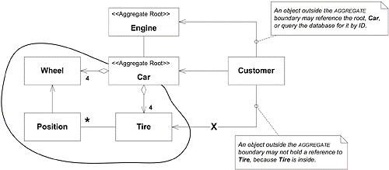
A Model expressed in software Aggregates
„An Aggregate is a term used to define object ownership and the boundaries between objects and their relationships.”
Notes:
In Domain - Driven Design speak, an Aggregate is a term used to define object ownership and the
boundaries between objects and their relationships. It is used to define a group of associated objects that
are to be treated as one unit in regard to data changes.
Each Aggregate can only have one root object, and that object is an Entity object. The root of an Aggregate can hold references to the roots of other Aggregates, and objects inside of an Aggregate can hold references to one another, but nothing outside of the Aggregate boundary can access the objects inside of the Aggregate without going through that Aggregate’s root object.
Defining the Aggregates in a domain model is one of the hardest activities to get right in Domain - Driven
Design, and this is where you really need the help of an expert in the business domain that you are
dealing with to determine the right boundaries and associations. It is also an area that I end up
refactoring a lot as I begin to understand more about the business model of an application.

Slide 17
A Model expressed in software Repositories
„represents all objects of a certain type as a conceptual
set (usually emulated)”
Notes:
According to Eric Evans, a repository “ represents all objects of a certain type as a conceptual set (usually
emulated) ”
He also goes on to say that for every object that is an Aggregate, create a repository for the object and give it the look and feel of an in - memory collection of objects of that particular type.
The main point of repositories is to keep the developer focused on the domain model logic, and hide the plumbing of data access behind well - known repository interfaces. This concept is also known as persistence ignorance , meaning that the domain model is ignorant of how its data is saved or retrieved from its underlying data store or stores.

Slide 18
A Model expressed in software Factories
There are two types of Factories:
building the root Entity of an Aggregate (usually from some type of resultset data)
building Value objects (usually from some type of configuration data)
Notes:
As the Entities and their associated Aggregates start to grow in the domain layer, it becomes increasingly
more difficult to build up objects consistently just using constructors. Lots of times there is intimate
knowledge needed to construct an Aggregate and all of its relationships, constraints, rules, and the like.
Instead of making the Entity objects themselves responsible for this creation, it is better to have a Factory
that knows how to build these types of objects, and thus avoid clouding up the code of an Entity object.
In Domain - Driven Design, there are two types of Factories, those for building the root Entity of an
Aggregate (usually from some type of resultset data) and those for building Value objects (usually from
some type of configuration data).

Slide 19
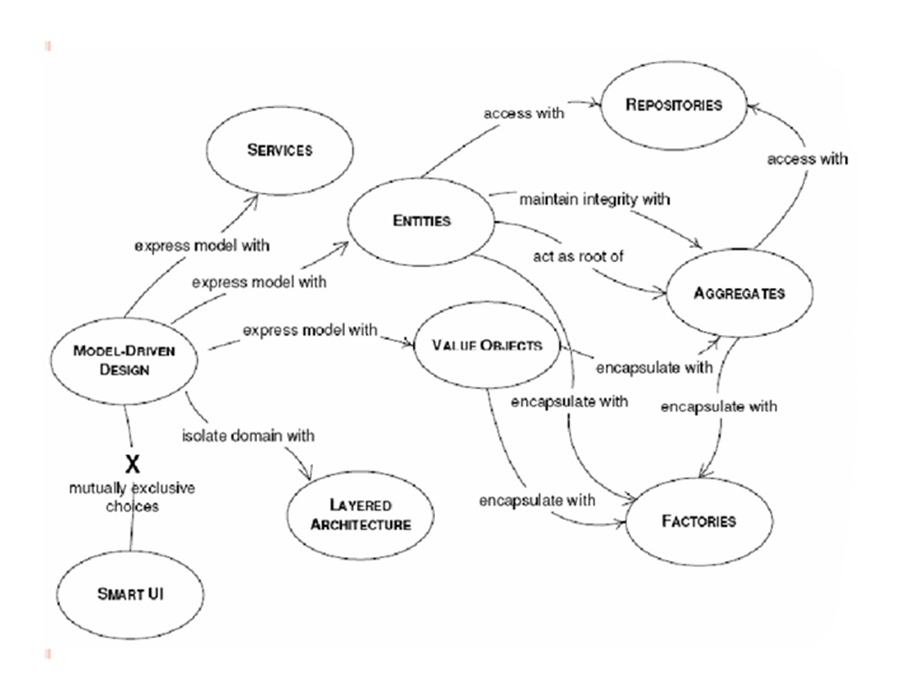
Summary
Notes:
A domain model offers several benefits some of which are:
It helps the team create a common model, between the business and IT stakeholders in the company, that the team can use to communicate about the business requirements, data entities, and process models
- The model is modular, extensible and easy to maintain as the design reflects the business model
- It improves the reusability and testability of the business domain objects
One principle behind DDD is to bridge the gap between domain experts and developers by using the same language to create the same understanding. Another principle is to reduce complexity by applying object oriented design and design patters to avoid reinventing the wheel.

Slide 20
Application design
User Interface
- Presenting information to the user - Interpreting user commands
- Coordinates the application activity
Application
- Can hold the state of an application
task’s progress
- Holds the state of business objects
- Encapsulates business logic
Domain
- Supporting role for other layers
- Implements persistance for
business objects
Infrastructure
Notes:
A typical DDD enterprise application architecture consists of the following four conceptual layers:
1. User Interface (Presentation Layer)
2. Application Layer
3. Domain Layer
4. Infrastructure Layer
---------------------------------------------------------
A typical DDD enterprise application architecture consists of the following four conceptual layers:
1. User Interface (Presentation Layer)
Responsible for presenting information to the user
Interpreting user commands
2. Application Layer
Coordinates the application activity
It doesn't contain any business logic.
It does not hold the state of business objects
It can hold the state of an application task's progress
3. Domain Layer
Contains information about the business domain and logic
The state of business objects is held here
Persistence of the business objects and possibly their state is delegated to the infrastructure layer
4. Infrastructure Layer
Acts as a supporting library for all the other layers
Provides communication between layers
Implements persistence for business objects
Contains supporting libraries for the user interface layer, etc.
From a design stand-point, the domain layer should have a well defined boundary to avoid the corruption of the layer from non-core domain layer concerns such as vendor-specific translations, data filtering, transformations, etc. Domain elements should be designed to hold the domain state and behavior correctly.

Slide 21
Iteration cycle diagram
Model The Domain
Refine the Model
Design / Architecture
DDD,
Design Patterns
Agile Project Management
Implementation
Development / Refactoring
SCRUM, XP
Unit / Integration testing
Code Generation
Continuous Integration
TDD, Automated Developer Tests
Notes:
From a project management stand-point, a real-world DDD implementation project comprises the same phases as any other software development project.
These phases include:
- Model the domain
- Design
- Development
- Unit and Integration Testing
- Refine and refactor the domain model based on the design and development (Continuous Integration (CI) of model concepts).
An agile software development methodology is a great fit here because agile methodologies focus on the delivery of business value just like DDD focuses on the alignment of software system with business model. Also, with the iterative nature of DDD, agile methodologies such as SCRUM or DSDM are better frameworks to manage the project. Using SCRUM (for project management) and XP (for software development purposes) methodologies is a good combination for managing a DDD implementation project.
Refactoring
Refactoring is changing or restructuring the application code without changing the functionality or behavior of the application. Refactoring can be either design or code related. Design refactoring is done to continually refine the model and refactor the code to improve the domain model.
Refactoring plays an important role in the DDD project due to its iterative and evolutionary nature of domain modeling. One way to integrate refactoring tasks into the project is to add it in each iteration of the project before calling the iteration done. Ideally, refactoring should be done before and after every development task.
Refactoring should be done with strict discipline. Use the combination of refactoring, CI, and unit testing to make sure the code changes didn't break any functionality and at the same time the changes did help with the intended code or performance improvements.
Unit Testing/Continuous Integration
Automated tests play a vital role in refactoring the application code. Without good automated developer tests and Test Driven Development (TDD) practices, refactoring can be counter-productive since there will be no automated way to verify that the design and code changes made as part of refactoring effort didn't change the behavior or break the functionality.
One of the goals we talked about earlier is that the domain classes should be unit testable (during the initial development as well as later when refactoring the existing code) without too many dependencies on the container or other infrastructure code. TDD approach helps the team in finding any design problems early in the project as well as verifying that the code is in alignment with domain model. DDD is ideal for Test-First development because the state and behavior are contained in domain classes and it should be easy to test them in isolation. It is important to test the state and behavior of domain model and not focus too much on the implementation details of data access or persistence.
Mock objects also help in testing the domain objects in isolation. But it's important to not go crazy with using mock objects in the domain layer. If there are other easy ways to test domain classes, you should use those options instead of using mock objects.
All unit and integration tests created during the development phase (with or without using TDD practices) will become part of the automated test suite once the development tasks are done. These tests should be maintained and executed frequently in the local and higher development environments to find if the new code changes introduced any bugs into domain classes.

Slide 22
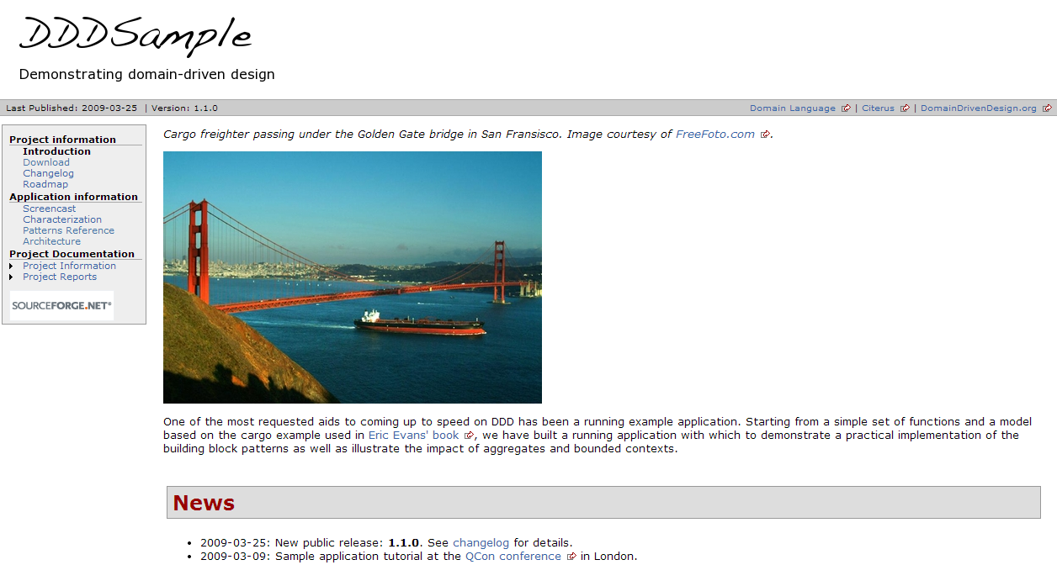
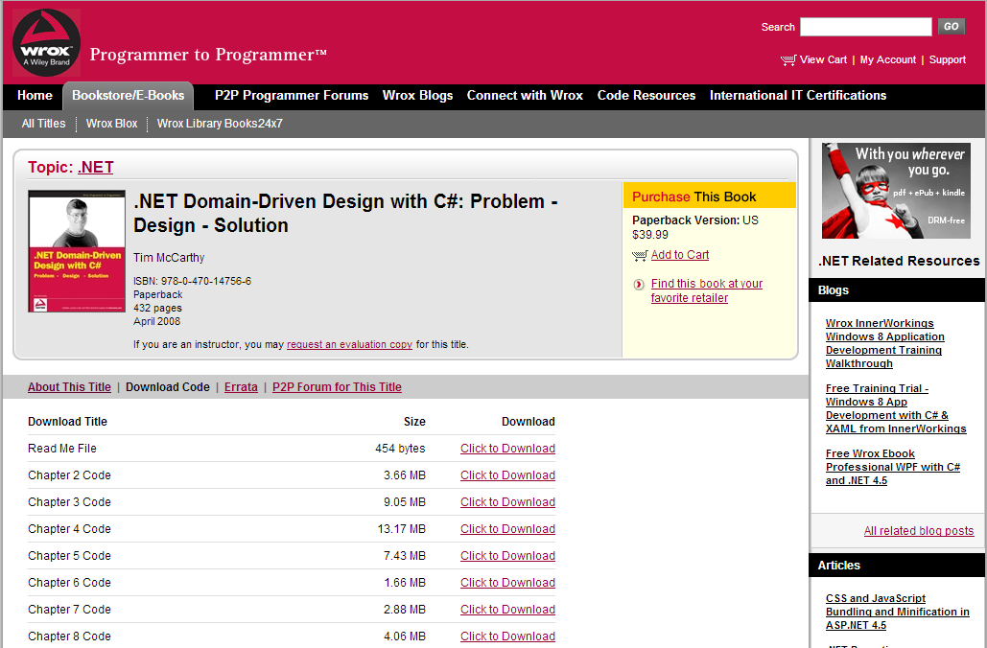
Example in VS
http://dddsample.sourceforge.net/
http://www.wrox.com/WileyCDA/WroxTitle/-NET-Domain-Driven-Design-with-C-Problem-Design-Solution.productCd-0470147563,descCd-DOWNLOAD.html

Slide 23

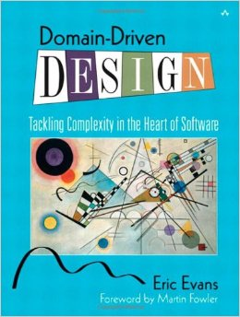
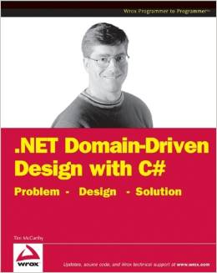
References

Slide 24
References
http://dddsample.sourceforge.net/
http://www.wrox.com/WileyCDA/WroxTitle/-NET-Domain-Driven-Design-with-C-Problem-Design-Solution.productCd-0470147563,descCd-DOWNLOAD.html
http://www.mirkosertic.de/doku.php/architecturedesign/dddexample
http://www.infoq.com/presentations/strategic-design-evans
http://www.infoq.com/presentations/model-to-work-evans
http://msdn.microsoft.com/pl-pl/magazine/dn342868(en-us).aspx
http://www.infoq.com/articles/ddd-in-practice

Slide 25
Questions?
Thank you!

Slide 26
Design patterns working group
Main activities:
- Review of current architectures and frameworks in EDIT
- Patterns analyze and learning on real examples
To be considered:
- Collaboration with other working groups
- Recommendations
- Audits
To be considered in future:
- Ready to use components
- Credit Suisse Application Design Framework
Goals:
- Broaden knowledge in area of design patterns
- Increase quality of delivered products
- Improve communication with stakeholders
In wider perspective:
- Increase maturity of Polish site
-
-

Slide 27
Domain Driven Design Modeling example
Maciej Zelwak
Notes:
Domain driven design effort begins where domain modeling ends. Most people recommends the following steps on how to go about implementing a domain object model. They emphasizes on putting more focus on domain objects than services in the domain model.
1. Start with domain entities and domain logic (without service layer initially).
2. Add services only where the logic doesn't belong in any domain entity or value object.
3. Use Ubiquitous Language, Contracts design, Automated Tests, Continuous Integration and Refactoring to make the implementation as closely aligned as possible with the domain model.
Lets focus a little on design. From the design and implementation stand-point, a typical DDD framework should support the following features:
1. It should be a POJO (or POCO if your company is a .NET shop) based framework.
2. It should support the design and implementation of a business domain model using the DDD concepts.
3. It should support concepts like Dependency Injection (DI) and Aspect Oriented Programming (AOP) out of the box, Integration with unit testing frameworks such as JUnit, NUnit, Tests integrated with VS, etc.
4. Good integration with other frameworks like Hibernate, Nhibernate, etc.
A domain modeling project typically includes the following steps:
Model and document business processes first.
Select a candidate business process and work with the business domain experts to document it using the Ubiquitous Language.
Identify all the services that are required for the candidate business process. These services can be atomic (single step) or orchestrated (multi-step with or without work-flow) in nature. They can also be business (e.g. Underwriting or Funding) or infrastructure (e.g. E-mail or Job Scheduling).
Identify and document the state and behavior of the objects used by services identified in the previous step.
When Modeling the Domain, Forget About Persistence
Modeling the domain is all about focusing on the tasks of the business. When designing types and their properties and behaviors, I’m sorely tempted to think about how a relationship will work out in the database and how my object relational mapping (ORM) framework of choice—Entity Framework—will treat the properties, relationships and inheritance hierarchies that I’m building. Unless you’re building software for a company whose business is data storage and retrieval—something like Dropbox—data persistence only plays a supporting role in your application.

Slide 28
Background and functional requirements
A company provides IT Body Leasing. They have some Employees, and also a lot of Freelancers as Subcontractors. Currently, they use Excel sheets to manage their Customers, Freelancers, Timesheets and so on. The Excel solution does not scale well. It is not multi-user ready and also does not provide security and audit logs. So they decided to build a new web based solution.
Other requirements:
- A searchable catalog of Freelancer must be provided
- The new solution must allow do store the different Communication Channels available to contact a Freelancer
- A searchable catalog of Projects must be provided
- A searchable catalog of Customers must be provided
- The Timesheets for the Freelancers under contract must be maintained

Slide 29
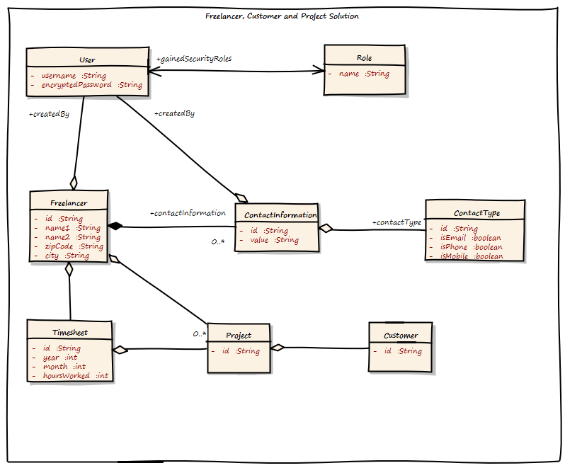
The big picture
- Very big object graph
- Association between User and Role bi-directional
- ContractType has some boolean flags
- The Freelancer class holds a list of Projects
- What does ContactInformation mean?
Notes:
It is a very big object graph. If they do not use Hibernate/ JPA lazy loading here, it will pretty sure run out of memory under heavy load
Why is the association between User and Role bi-directional?`
The ContactType has some boolean flags to show what type is it, email, phone, mobile
The Freelancer class holds a list of Projects. This also means that Projects cannot be added without modifying the Freelancer object. This can cause transaction failure under heavy load, as possibly multiple users are adding Projects for the same Customer.
What does ContactInformation mean? The requirements stated “Communication Channel”. Is it the same?

Slide 30
Indentifying domains
- Identity and Access Management Subdomain
- Freelancer Management Subdomain
- Customer Management Subdomain
- Project Management Subdomain
The separated Domain can easily be visualized. In DDD terms this is called a Context Map, and it is the starting point for any further modeling.
Notes:
We can split the big problem into smaller ones. This can help us to design a better solution. The separated Domain can easily be visualized. In DDD terms this is called a Context Map, and it is the starting point for any further modeling.

Slide 31
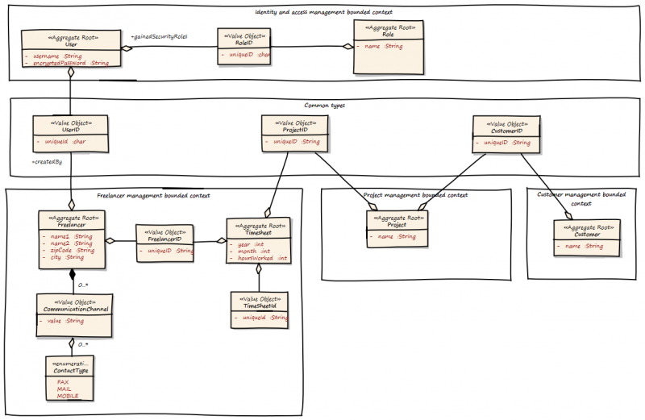
The new big picture

Slide 32
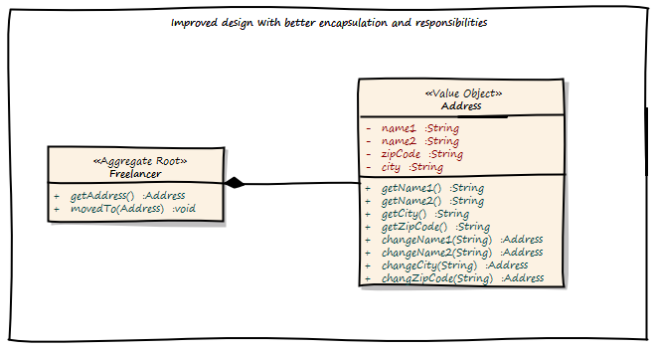
Designing behavior

Slide 33
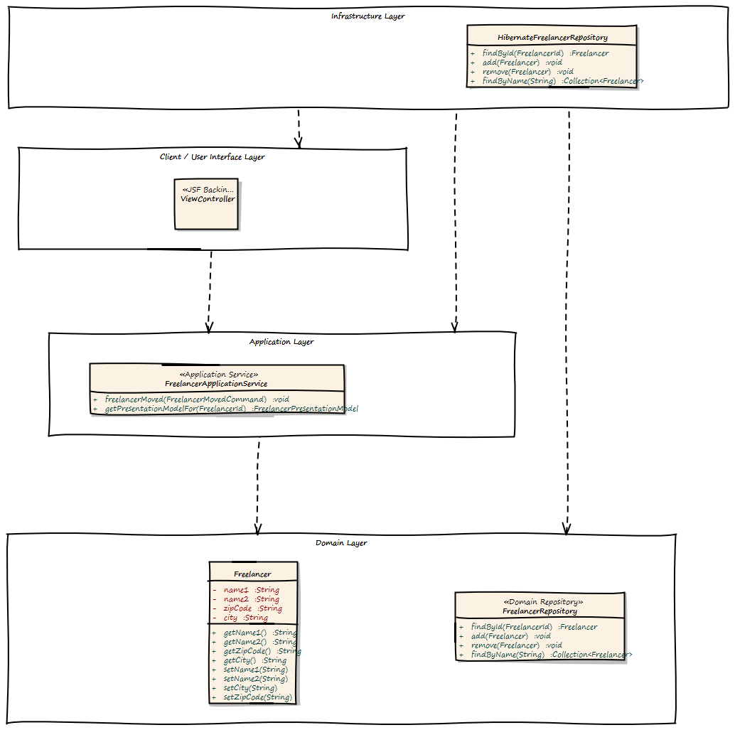
Freelancer subdomain

Slide 34
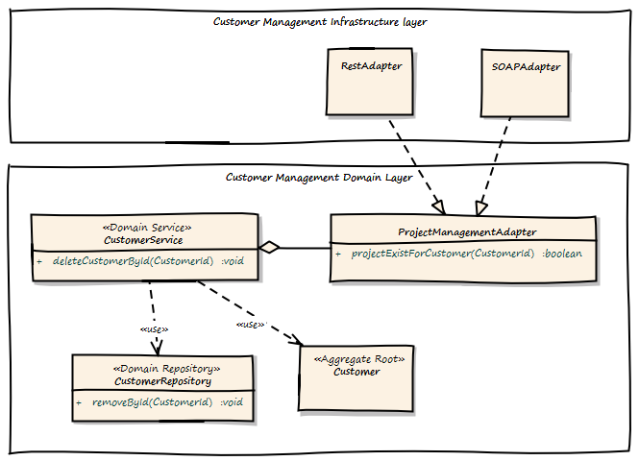
Adapters, Generic Domains, Events

Slide 35
Example in VS
http://dddsample.sourceforge.net/
http://www.wrox.com/WileyCDA/WroxTitle/-NET-Domain-Driven-Design-with-C-Problem-Design-Solution.productCd-0470147563,descCd-DOWNLOAD.html

Slide 36
References

Slide 37
References
http://dddsample.sourceforge.net/
http://www.wrox.com/WileyCDA/WroxTitle/-NET-Domain-Driven-Design-with-C-Problem-Design-Solution.productCd-0470147563,descCd-DOWNLOAD.html
http://www.mirkosertic.de/doku.php/architecturedesign/dddexample
http://www.infoq.com/presentations/strategic-design-evans
http://www.infoq.com/presentations/model-to-work-evans
http://msdn.microsoft.com/pl-pl/magazine/dn342868(en-us).aspx
http://www.infoq.com/articles/ddd-in-practice

Slide 38
Questions?
Thank you!

